Slide 1


Analysis of Social Buzz’s
content categories

Slide 2


Today's agenda
Project recap
Problem
The Analytics team
Process
Insights
Summary

Slide 3

Social Buzz, a rapidly expanding tech unicorn, urgently needs to adjust to its global expansion. To address this, Accenture has initiated a three-month POC with a focus on the following tasks:
• An audit of Social Buzz's big data practice
• Recommendations for a successful IPO
• Analysis to find Social Buzz's top 5 most popular categories of content
Project Recap

Slide 4


Problem
Daily Volume: 100,000+ posts
Annual Content: 36.5 million pieces
Key Objective: Identify top 5 most popular content categories through data analysis

Slide 5


Benedicta Ikuabe (Data Analyst)
The
Analytics
Team
Marcus Rompton (Senior Principle)
Andrew Fleming (Chief Technical Architect)

Slide 6
Process
1
Identify, using data models, which data set is required to solve the problem(Understanding the data)
2
Data cleaning
3
Data modelling
Analysing the data
4
5
Creating data visualization (Uncover insights)

Slide 7

Insights
16
UNIQUE
CATEGORIES
1897
REACTIONS TO “ANIMALS” POST
MAY
MONTH WITH MOST POST

Slide 8
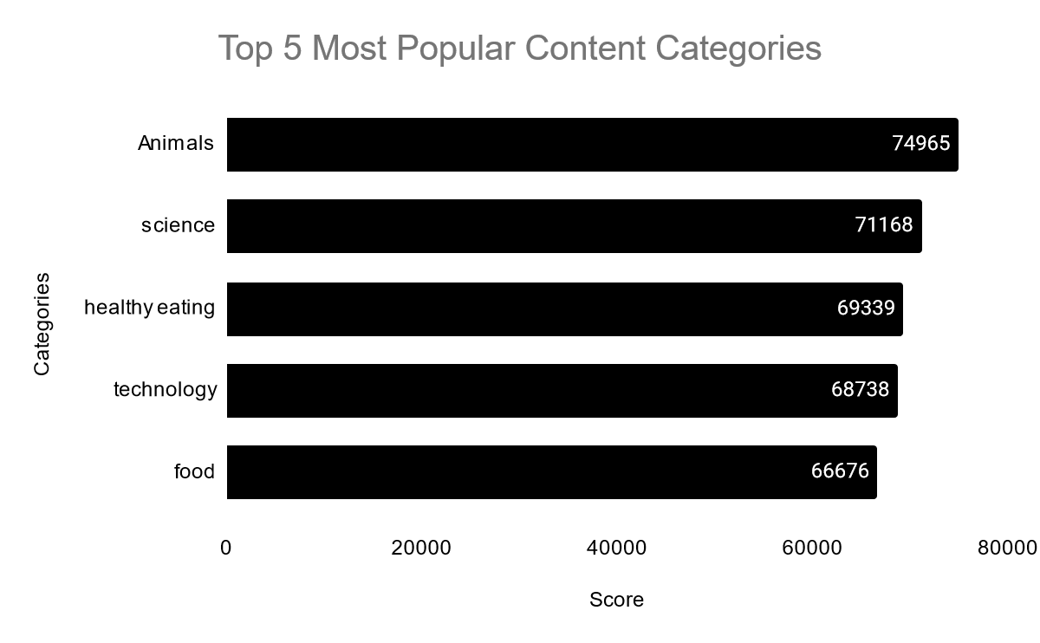

Slide 9
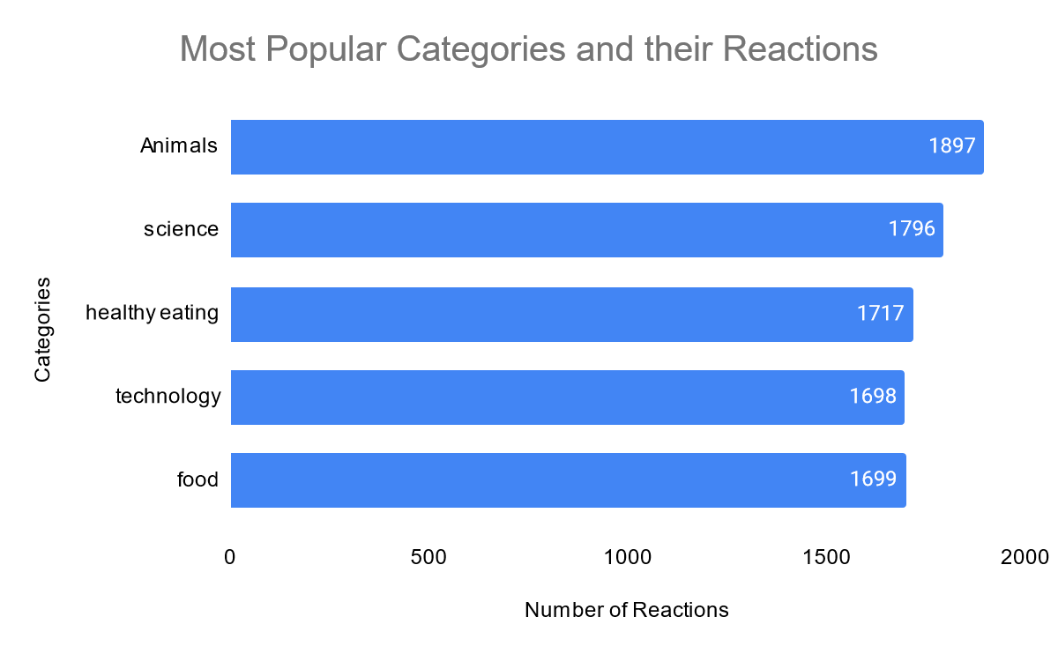

Slide 10
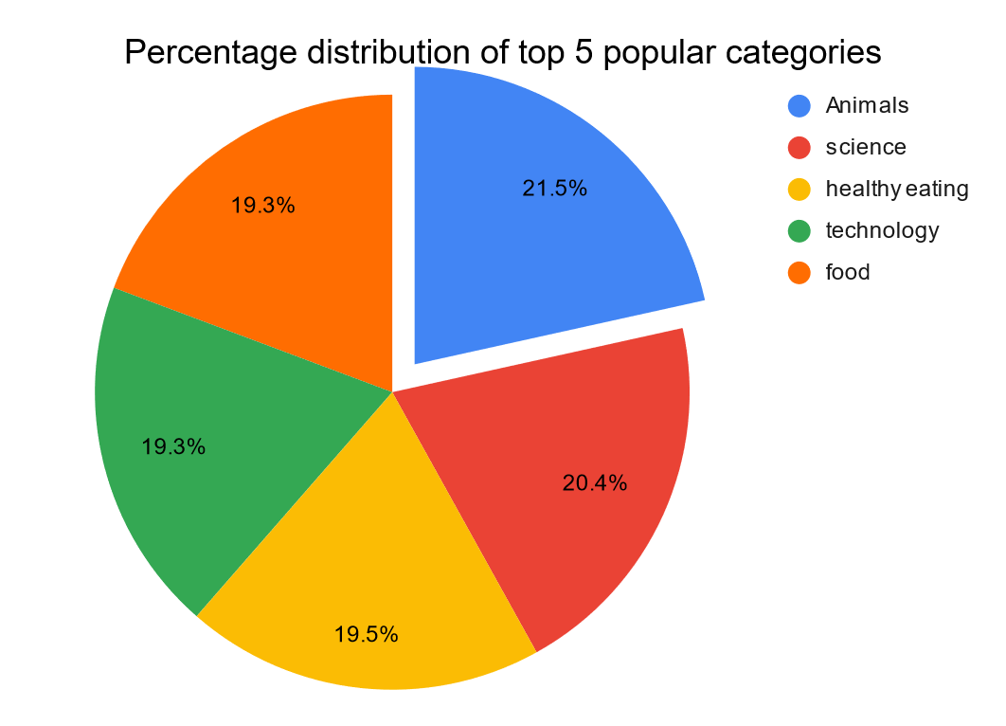

Slide 11
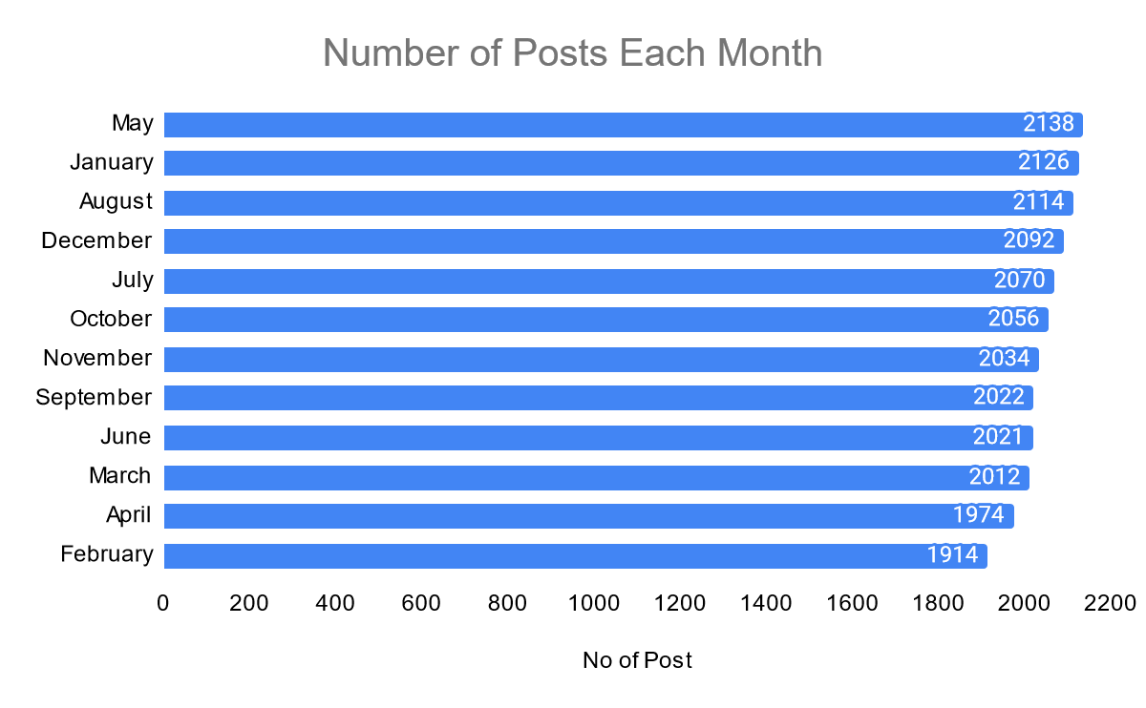

Slide 12

ANALYSIS
Content focused on animals and science attracts the most interest, indicating a preference for reality-based and informative material.
INSIGHT
Food-related topics generally rank high with “Healthy Eating" leading in popularity. This suggests a strong audience interest in nutrition and wellness. Collaborating with brands in the healthy eating sector could enhance user interaction.
ACTION PLAN
This preliminary review offers useful information, but expanding to a continuous, in-depth analysis will yield greater business insights. We can support you in making this shift.
Summary

Slide 13

Thank you!
ANY QUESTIONS?

